Slide 1



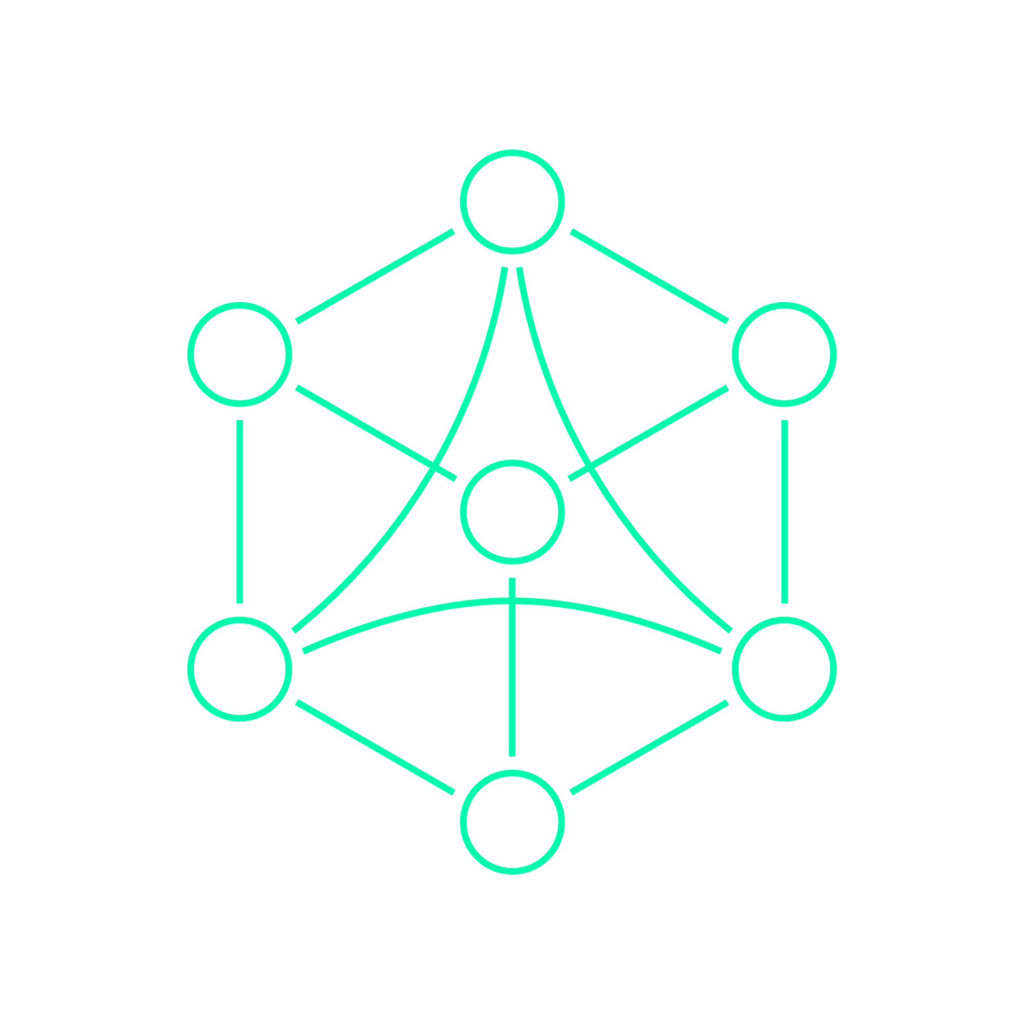
DES 03: Head-Unit
<Team 5>
DongHwan Seo
Mounika Vinjarapu
Sujong Ha
23.10.23

Slide 2
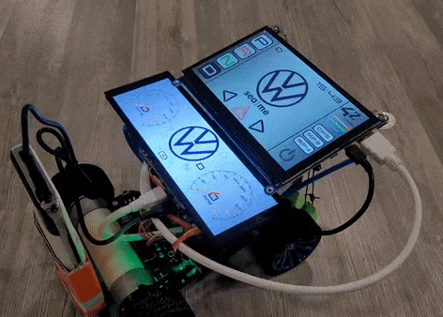
INTRODUCTION
The main goal of the
Head-Unit project
is to create a functioning
Instrument Cluster & Head Unit for a PiRacer using yocto

Slide 3
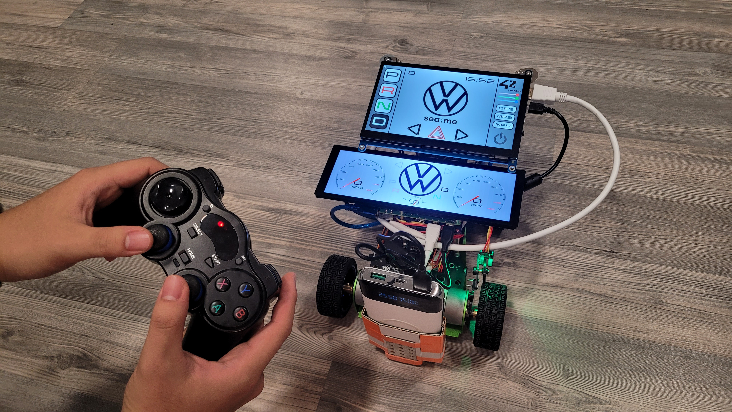
INDEX
Hardware & Software Setup
Yocto
System architecture
CommonAPI & vsomeip
Independent processes
Execution time
Demonstration

Slide 4
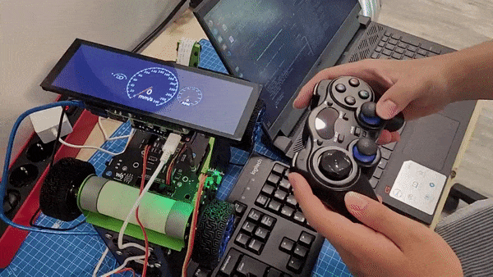
1. Hardware & Software Setup
(Final result of DES 02: Instrument-Cluster)

Slide 5
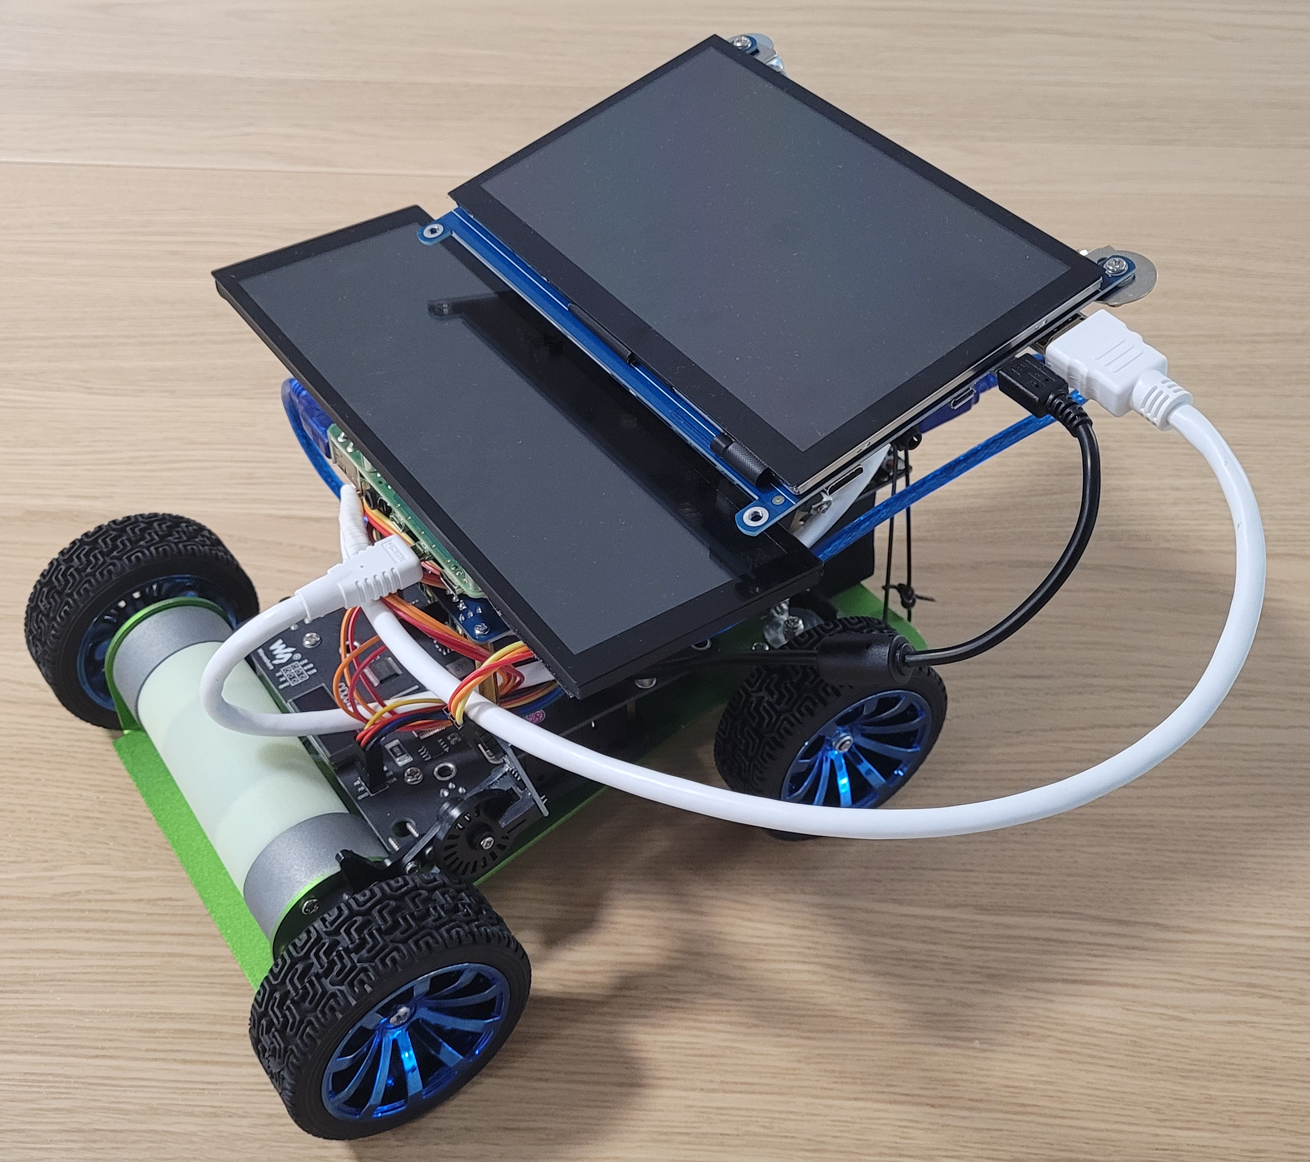
1. Hardware & Software Setup
Hardware
Software
〮 Raspberry Pi 4 B 4GB
〮 Waveshare Piracer
〮 2-CH CAN FD HAT
〮 7.9inch DSI LCD
〮 7Inch HDMI LCD(H)
〮 Arduino UNO
〮 CAN-Bus Shield
〮 IR Speed Sensor
〮 Yocto - kirkstone
〮 Qt 5.15.0
〮 Piracer-py
〮 CommonAPI
〮 vsomeip

Slide 6
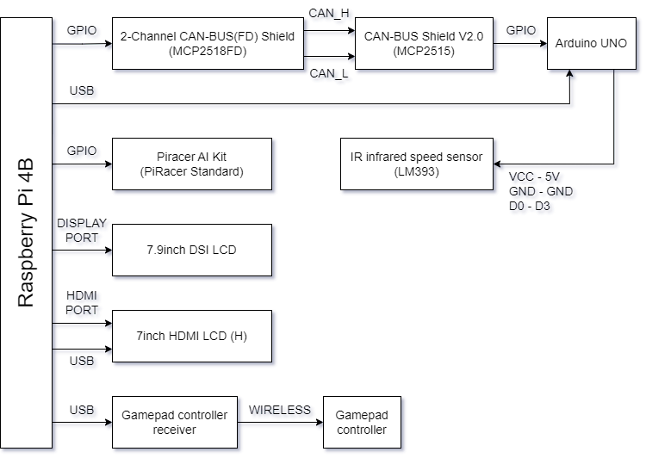

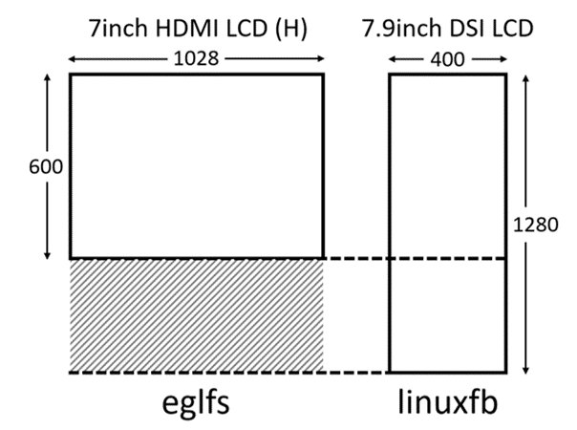
1. Hardware & Software Setup
Assembly guide
SEA-ME-COSS/DES-Head-Unit

Slide 7

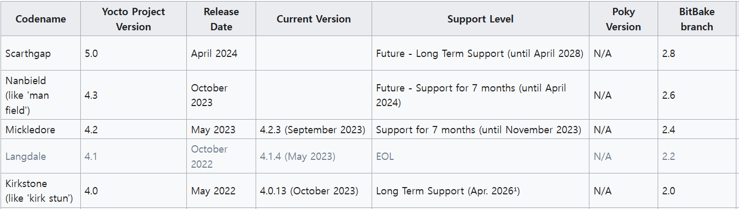
2. Yocto: kirkstone
〮 What is yocto?
〮 Why kirkstone?

Slide 8
2. Yocto: meta-infotianment
meta-infotainment
recipes-setting
recipes-example
recipes-module
recipes-kernel
recipes-connectivity
recipes-core

Slide 9
2. Yocto: meta-infotianment
〮 recipes-setting
Wifi, spi, CAN, Hdmi LCD, 7.9inch LCD
Vsomeip, common-api-c++, common-api-someip, boost
Qt5
Piracer
〮 recipes-kernel & recipes-connectivity
ISSUE : Waveshare-DSI-LCD can not display for yocto image with linux-raspberrypi 6.1.34 & 6.1.38 #1211
Change raspberrypi linux version to 6.1.46 using master branch

Slide 10
2. Yocto: meta-infotianment
〮 recipes-module
Clone our DES-Head-Unit; branch = kirkstone
Auto start
core-image-base.bbclass
〮 recipes-core
Infotainment-rpi-image.bbclass
IMAGE_FSTYPES
IMAGE_ROOTFS
CORE_IMAGE_BASE_INSTALL
Infotainment-rpi-image.bbappend
All packages
Infotianment-rpi-image.bb
Users & Group
Auto login
IMAGE_LIGUAS

Slide 11
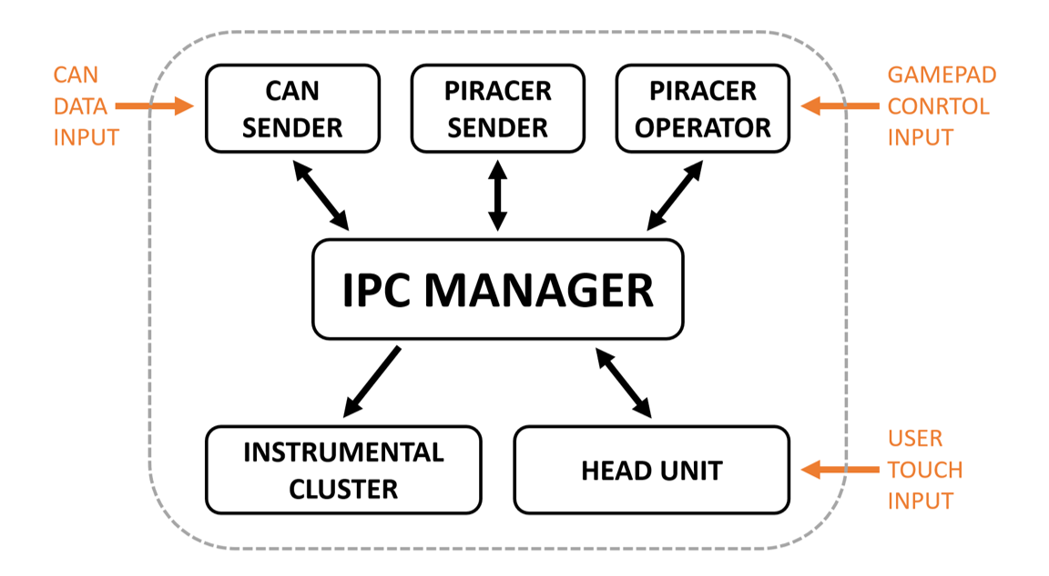
3. Architecture

Slide 12
3. Architecture

Slide 13
3. Architecture

Slide 14
3. Architecture
Intersection

Slide 15
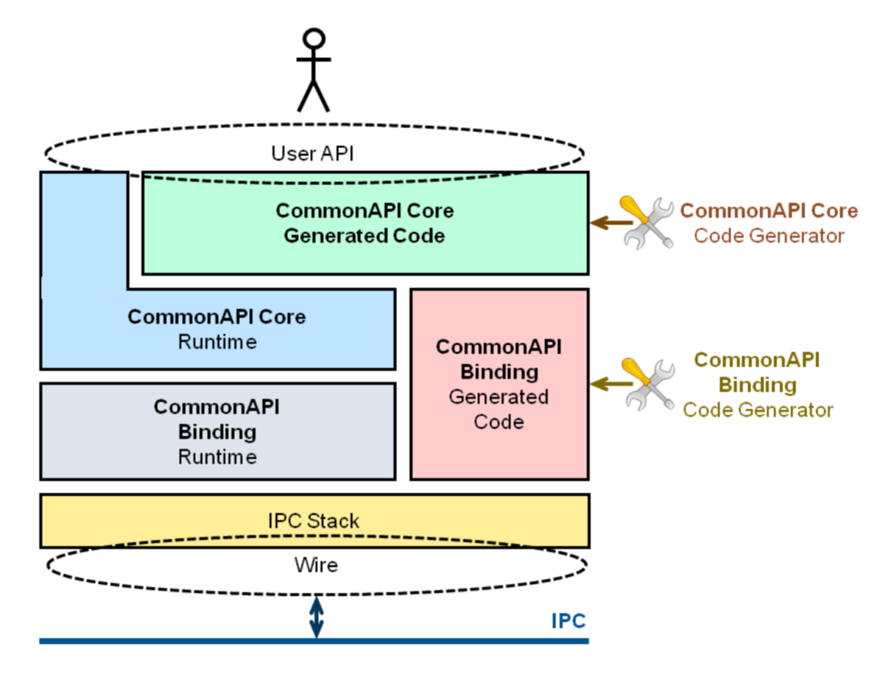

4. CommonAPI & vsomeIP
Someip or DBUS
Binding
vsomeip stack

Slide 16
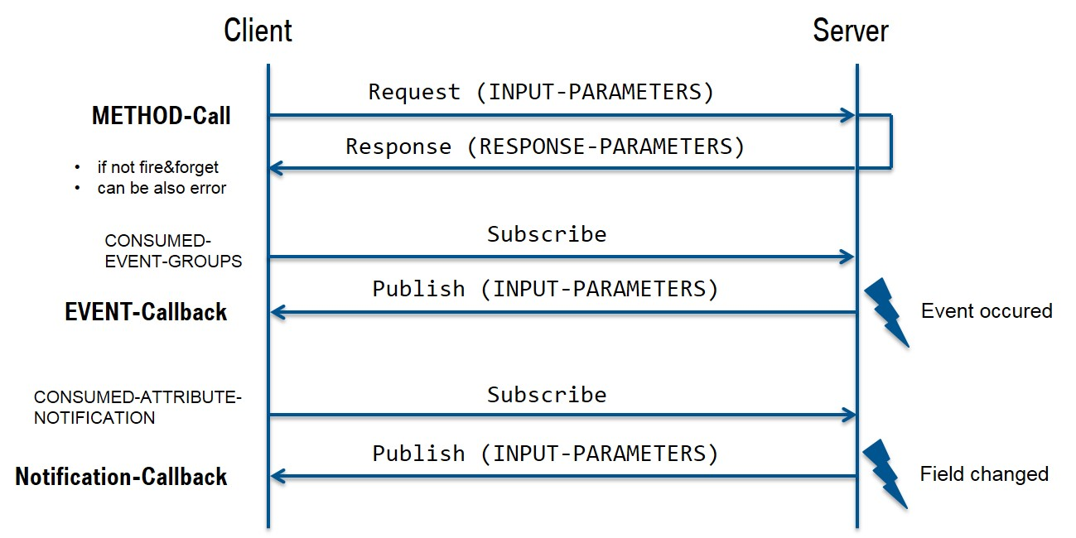
4. CommonAPI & vsomeIP

Slide 17
4. CommonAPI & vsomeIP
IPC Manager
End point
Start point

Slide 18
4. CommonAPI & vsomeIP
IPC Manager
Data
Reply
End point
Start point

Slide 19
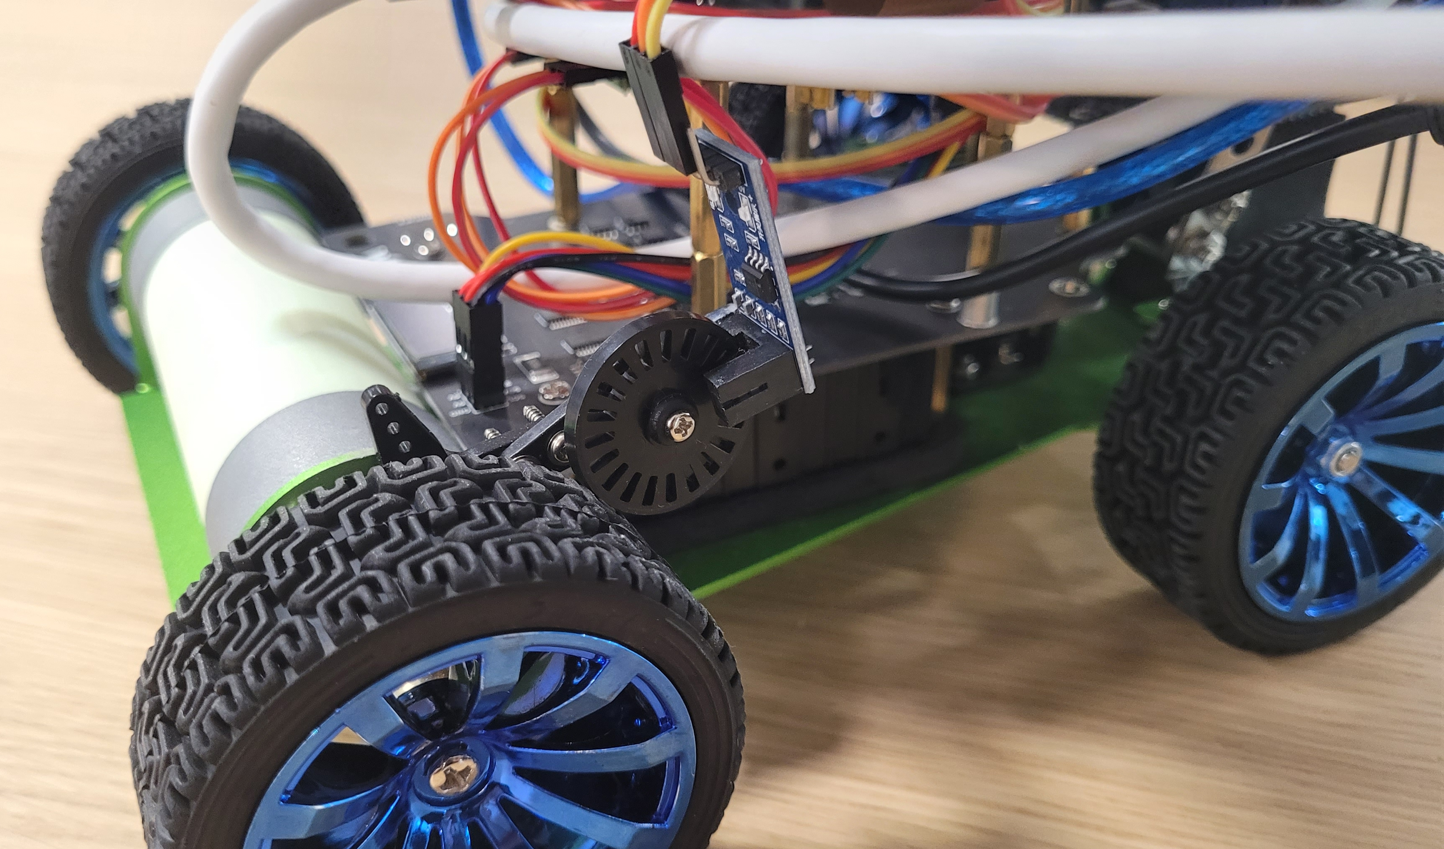
5. Independent processes
Speed

Slide 20
5. Independent processes
Battery
Level

Slide 21
5. Independent processes
Steering

Slide 22
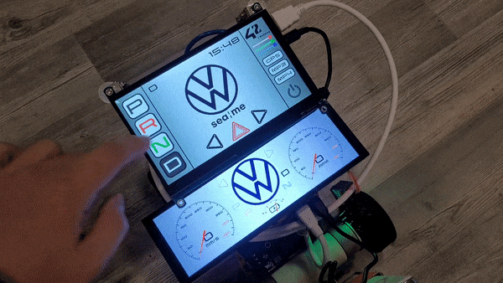
5. Independent processes
Turn indicator auto-off system

Slide 23
5. Independent processes
Gear
Mode

Slide 24
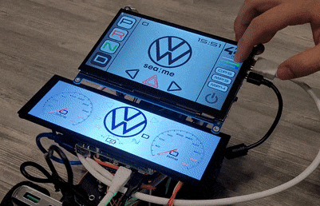
5. Independent processes
Turn Signal
&
Ambient Lighting
Color

Slide 25
5. Independent processes
Connectivity
Check

Slide 26
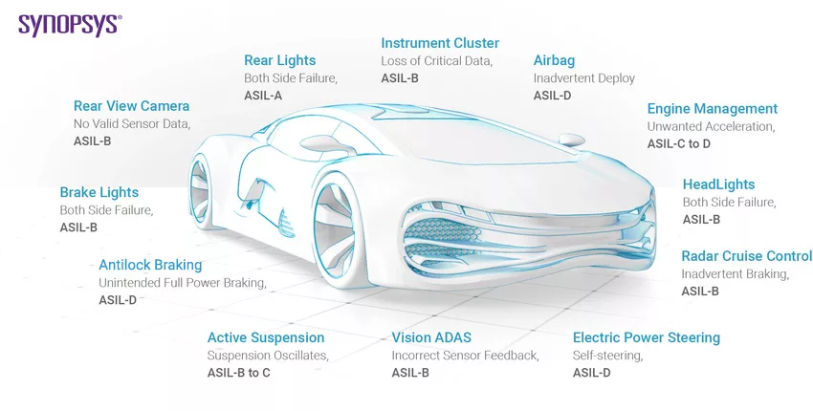
6. Execution time
ASIL
Automotive
Safety
Integrity
Level

Slide 27
6. Execution time
ASIL
Automotive
Safety
Integrity
Level

Slide 28
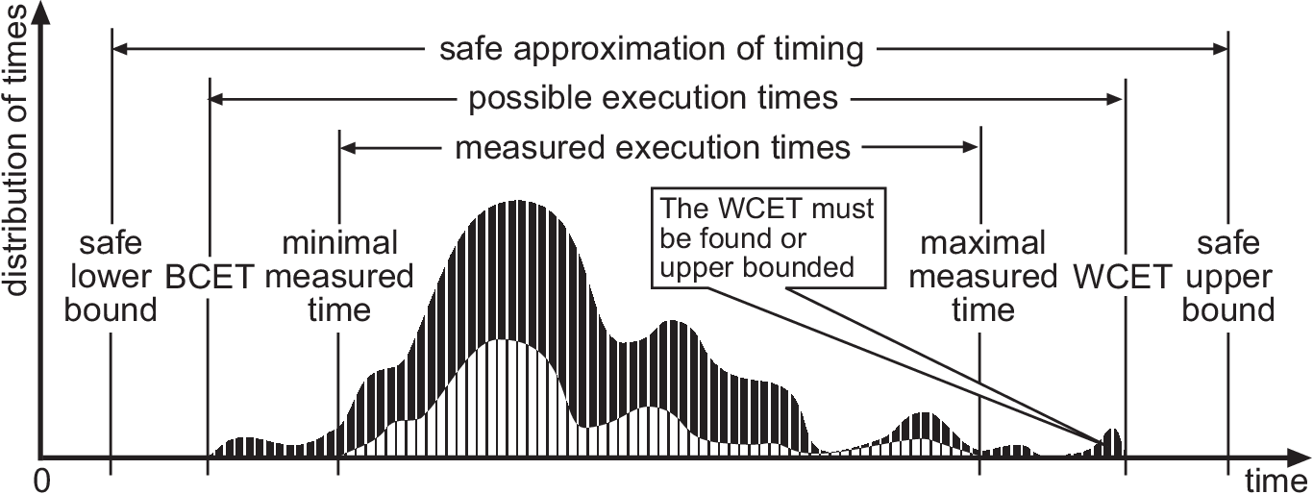
6. Execution time

Slide 29
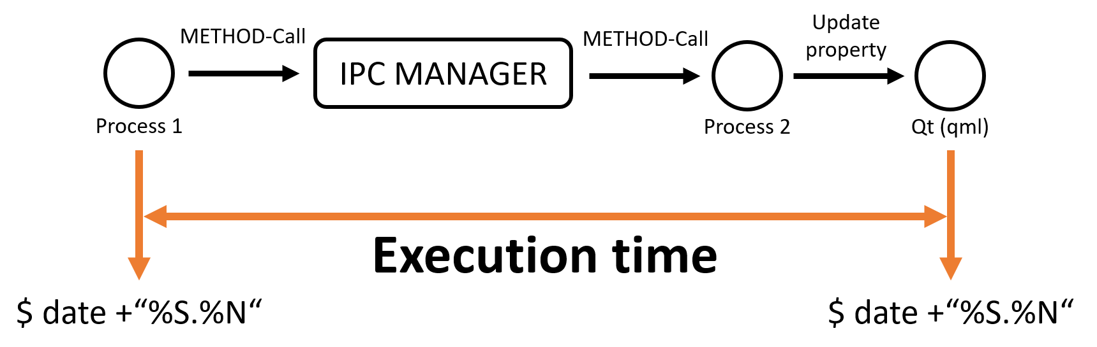
6. Execution time

Slide 30
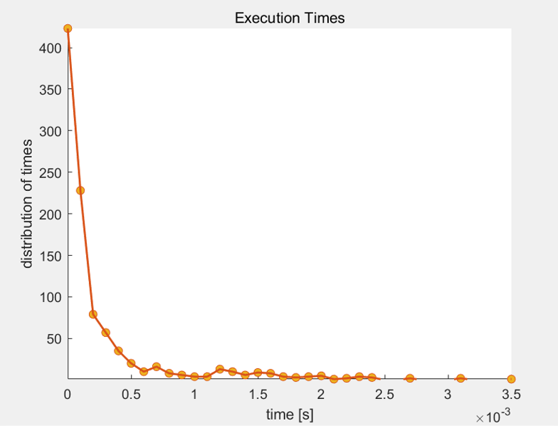
12. WCET

Slide 31
12. WCET
85% of the communications were performed within 0.5ms

Slide 32
12. WCET
WCET (measured)
3.5ms

Slide 33
12. WCET
(Reaction time of airbag: 40ms)
WCET (measured)
3.5ms

Slide 34
12. WCET
BCET (measured)
0.000000037ms
=37ns

Slide 35
12. WCET
BCET (measured)
0.000000037ms
=37ns
What about the Attribute-Callback implementation?

Slide 36
Demo
DongHwan Seo
Mounika Vinjarapu
Sujong Ha
23.10.23

Slide 37
Q&A
DongHwan Seo
Mounika Vinjarapu
Sujong Ha
23.10.23

Slide 38
Thank you!
DongHwan Seo
Mounika Vinjarapu
Sujong Ha
23.10.23

